Slide 1

Basic Details of the Team and Problem Statement
Name of the Students: Shaurya Srinet, Swetanshu Agrawal, Charvi Jain, Shounak Chandra
Problem Statement Title: Comprehensive Crack Detection and Severity Classification in Concrete Structures
Team Name: Binary Bandits
Team Leader Name: Shaurya Srinet
Department: Networking and Communications (NWC)
SRM TECHNO HACKATHON 2023

Slide 2
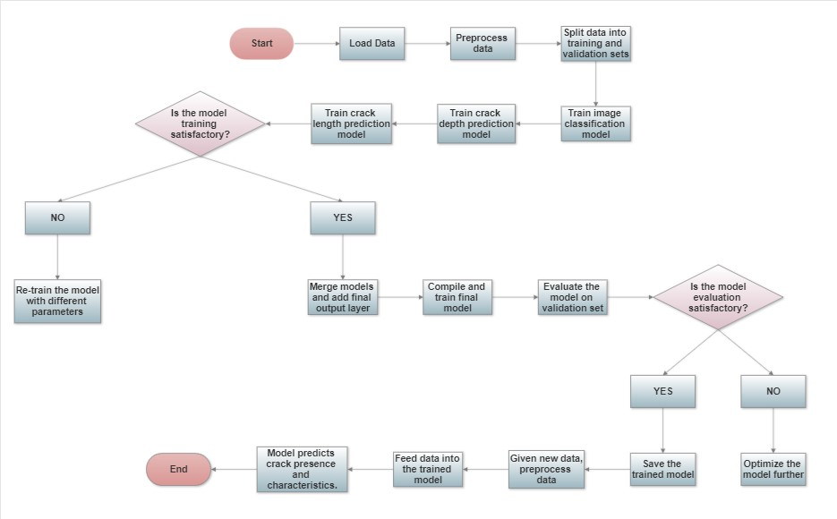
Problem Statement
Process Flowchart
The Crack Detection and Classification of Concrete Structures project aims to detect and categorize cracks in concrete structures accurately and efficiently. Concrete structures are prone to cracking due to several factors, such as aging, natural calamities, and heavy loads, compromising their safety. Traditional crack detection methods are time-consuming and require trained personnel, making them unsuitable for large-scale inspections. This project utilizes machine learning techniques to detect and classify crack types from images, enabling quick and efficient inspections to ensure concrete structures' safety and integrity.

Slide 3
Technology & Architecture
Technology
Architecture
Python programming language
Keras deep learning library
Convolutional Neural Network (CNN) architecture
ImageDataGenerator for data preprocessing
Adam optimizer for model training
Matplotlib and Seaborn libraries for data visualization
The project addresses crack detection, classification, and characterization in concrete structures.
It uses a multi-modal approach.
The image and crack depth models use CNN.
The image model takes input as images and outputs binary classification (presence of crack or not).
The crack depth model takes images and outputs continuous prediction of crack depth.

Slide 4
Technology & Architecture
Technology
Architecture
The project concatenates the outputs of several models, including image, depth, and length models, to arrive at final conclusions on the presence and characteristics of fractures in concrete buildings.
The project combines regularization and deep learning methods to efficiently identify and anticipate the occurrence of fractures in concrete buildings.
The crack length model takes images and outputs continuous prediction of crack length.
All sub-models are merged using concatenation and a dense layer with a sigmoid activation function produces the final output.
The model is trained using binary cross-entropy loss and mean squared error loss.

Slide 5
Dataset & Pseudocode
Dataset details
Pseudocode
The crack depth model was trained on a dataset of labeled images that provide information about the depth of cracks.
The dataset includes a variety of crack types and severities, from surface-level to deep cracks.
The images in the dataset were captured under different lighting conditions and using different cameras to improve generalizability.
Domain experts carefully annotated the dataset to ensure accuracy and consistency of the labels.
The size of the dataset is important in machine learning, and the dataset used for the crack depth model was sufficiently large to enable accurate predictions across various conditions.
Load and preprocess image and audio data
Split the data into training and testing sets
Define image classification model architecture
Define crack depth prediction model architecture
Define crack length prediction model architecture
Merge all models
Compile and train model
Evaluate model on testing set
Save trained model
Load saved model
Use model to predict crack presence, depth, and length on new images.

Slide 6
Completion Status & Learning
Completion Status
Learning
The crack depth model uses machine learning to predict the depth of cracks in images.
It extracts relevant features from images using various image processing techniques.
The model generates a continuous prediction of crack depth, which helps estimate the severity of the crack and plan repairs.
The model is trained on a large dataset of images that includes different types and severities of cracks, and is optimized to minimize prediction errors.
By providing accurate predictions of crack depth, the model can improve the safety and durability of infrastructure systems like buildings, bridges, and roads.
The crack depth model uses machine learning to predict crack depth from images.
It is trained using labeled images that include information about crack depth.
The model iteratively adjusts its parameters during training to minimize prediction errors.
Once trained, the model can accurately estimate crack depth in new images.
Machine learning involves using algorithms to identify patterns and make predictions, which is crucial for the crack depth model to improve infrastructure safety.

Slide 7
Team Member Details
Team Leader Name: Shaurya Srinet
Branch : B.Tech Stream : CSE W/S IOT Year : II
Team Member 1 Name: Swetanshu Agrawal
Branch : B.Tech Stream : CSE W/S AI ML Year : II
Team Member 2 Name: Charvi Jain
Branch : B.Tech Stream : AI Year : II
Team Member 3 Name: Shounak Chandra
Branch : B.Tech Stream : CSE W/S IOT Year : II
Team Mentor Name: Dr. Anupama C G
Category : Academic Expertise : AI/ML Domain Experience (in years): 10

Slide 8
THANK YOU!!

